Slide 1
Triggered Guitar Effects Platform
Ralph Carlo Quinto (CE), Bryan Guner (EE), Haley Scott (EE)
Advisor: Dr. Ambrose Adegbege

Slide 2
Overview
Problem Identification
Project Goals
Project Status
Pure Data
Video Demonstration
Digital Effects
Dynamic Time Warping
Project Management
Summary

Slide 3
Problem Identification
Guitar effect pedals physically restrain the guitar player
Effect pedals require presence of mind on the part of the performer
Analog and digital effects pedals are costly
Notes:
Explain in detail how electric guitar works
-Mention Effects pedals require presence of mind on the part of the performer to trigger them at the correct time, and to adjust the settings between songs or even between sections of songs
-Explain that these constraints limit the performer’s mobility and stage presence and split their focus away from playing their instrument
-Explain that digital effect software is a more cost effective option

Slide 4
Project Goals
Develop a software platform to analyze a time sequence of notes and trigger guitar effects as instructed
Consistently tolerate error in performance and recognize trigger points
Mitigate the latency between a detected match and the triggering event
Process sequences up to 10 note onsets per second

Slide 5
Team Breakdown
Bryan Guner | Team Lead - Develop a protocol for digital signal processing of the guitar signal in order to create a time-sequential record of the frequency content of the guitar signal and a comparison between pre recorded songs and live performances.
Ralph Quinto | Software Engineer - Research for possible programming platforms. Responsible for reading electric guitar signals, creating the signal analysis patches in pure data, and triggering digital guitar effects.
Haley Scott | Architectural Manager - Responsible for ensuring successful integration of project components, researching system methods, designing digital effects, Project and Organizational Management

Slide 6
Project Status
Purchased components
Created simplified guitar effect trigger patch
Generated digital guitar effects
Began the implementation phase of Dynamic Time Warping

Slide 7
Background (Pure Data)
Visual programming language (LabView)
Objects are linked together to model the flow of control and audio
Designed for creating interactive computer music and multimedia works.
Generate Waveforms
Perform Signal Analysis
Modular code base
Externals could be generated using C, C++, Python, Java, and many more
Open source project listed under a modified BSD License
all distributed copies of the source code must contain the BSD license

Slide 8
Project Specs (PD & Physical Components)
Pure Data Specs
Sampling rate of 44,100 Hz
Block size of 1024
Electric Guitar: Ibanez RG5EX1
Bridge Pickup: Infinity 4
Magnet: Ceramic
DC Resistance: 15.6 KΩ
Gauges: .009/.011/.016/.024/.032/.042

Slide 9
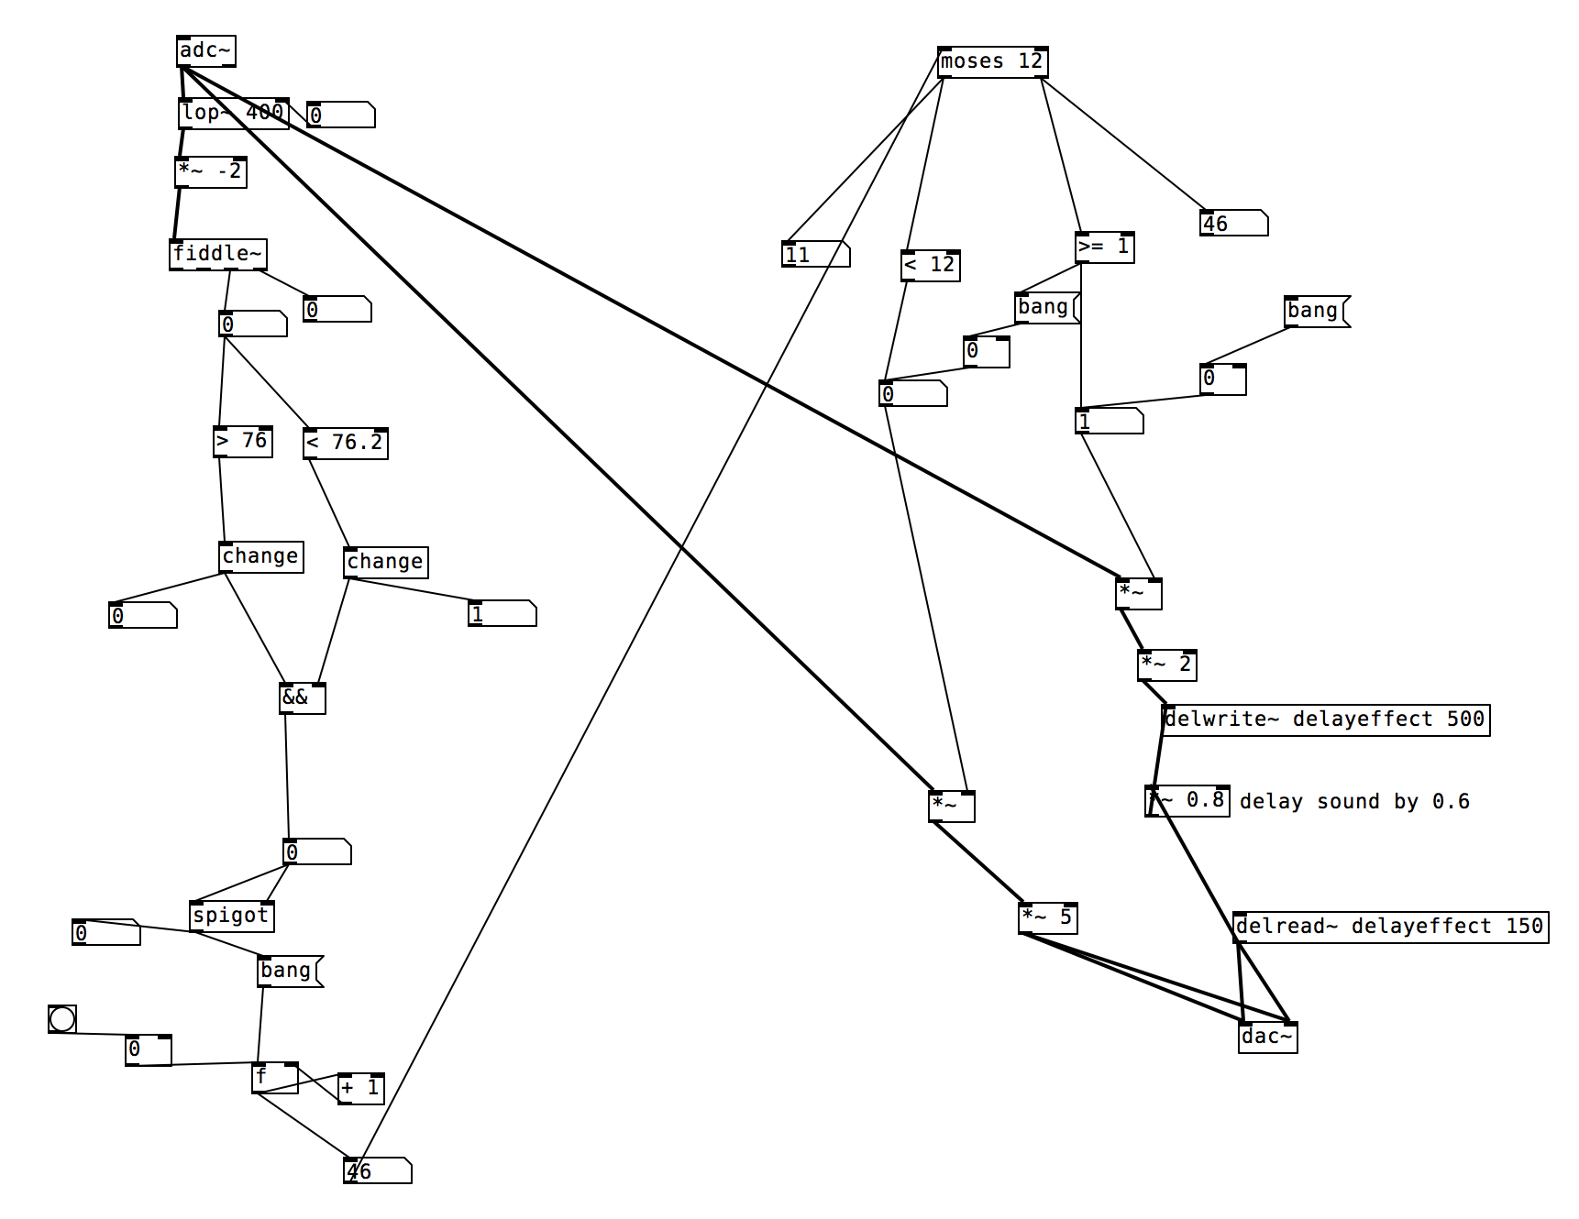
Current PD Implementation

Slide 10
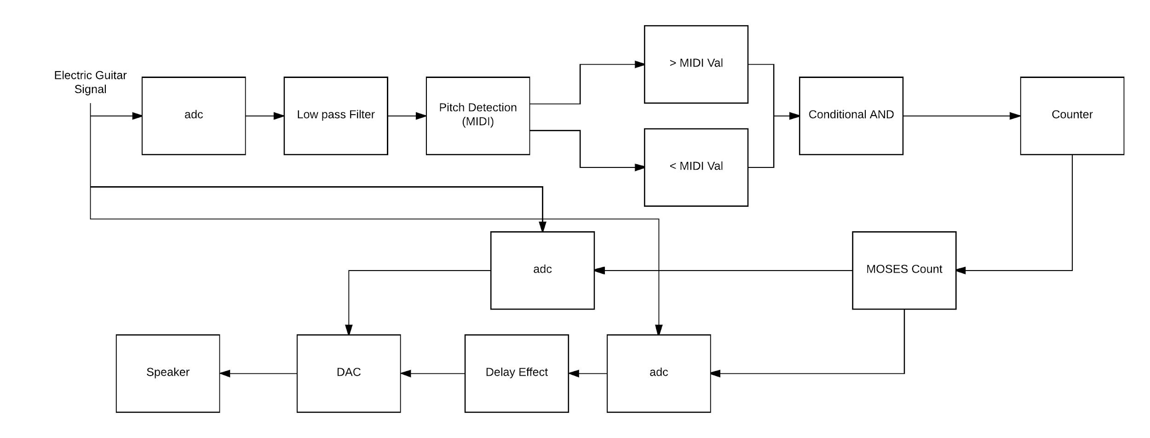
Block Diagram of Simplified PD Patch

Slide 11
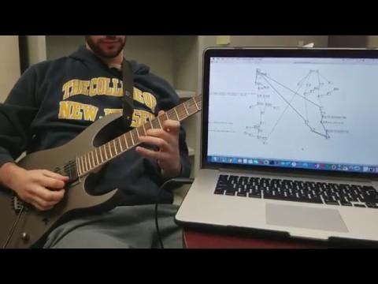
Video Demonstration

Slide 12
Issues With Approach
Sensitive to performance speed and articulation
Similar songs may trigger an effect configured for a specific song
Minor inconsistencies in count accuracy
Geared towards handling 1 note at a time

Slide 13
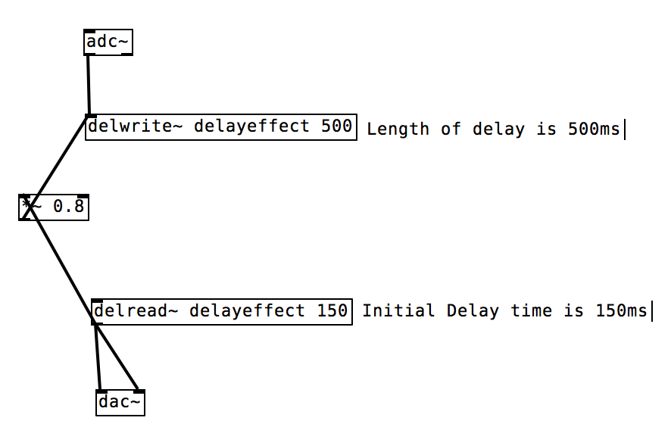
Delay Effect
Creates the sound of a repeating, decaying echo
Delwrite block allocates memory for a delay line
Delread block reads the signal from a delay line

Slide 14
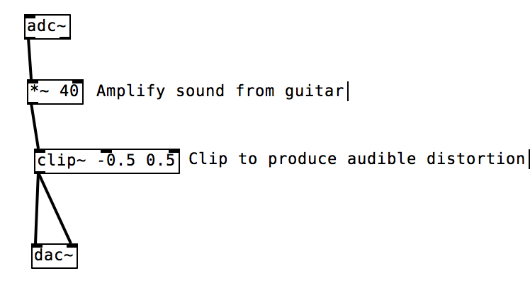
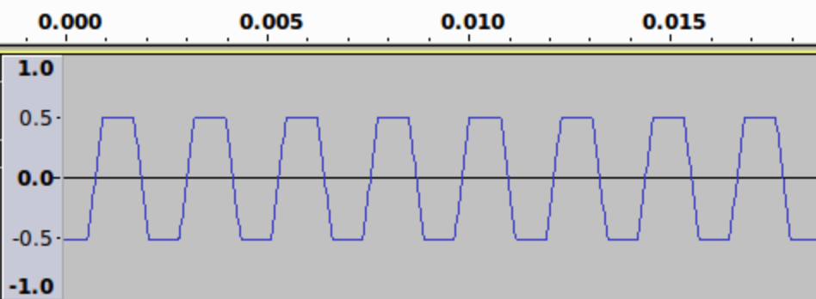

Fuzz Effect
Creates the sound of a distorted, heavier guitar
Clip block restricts a signal to lie between two limits

Slide 15
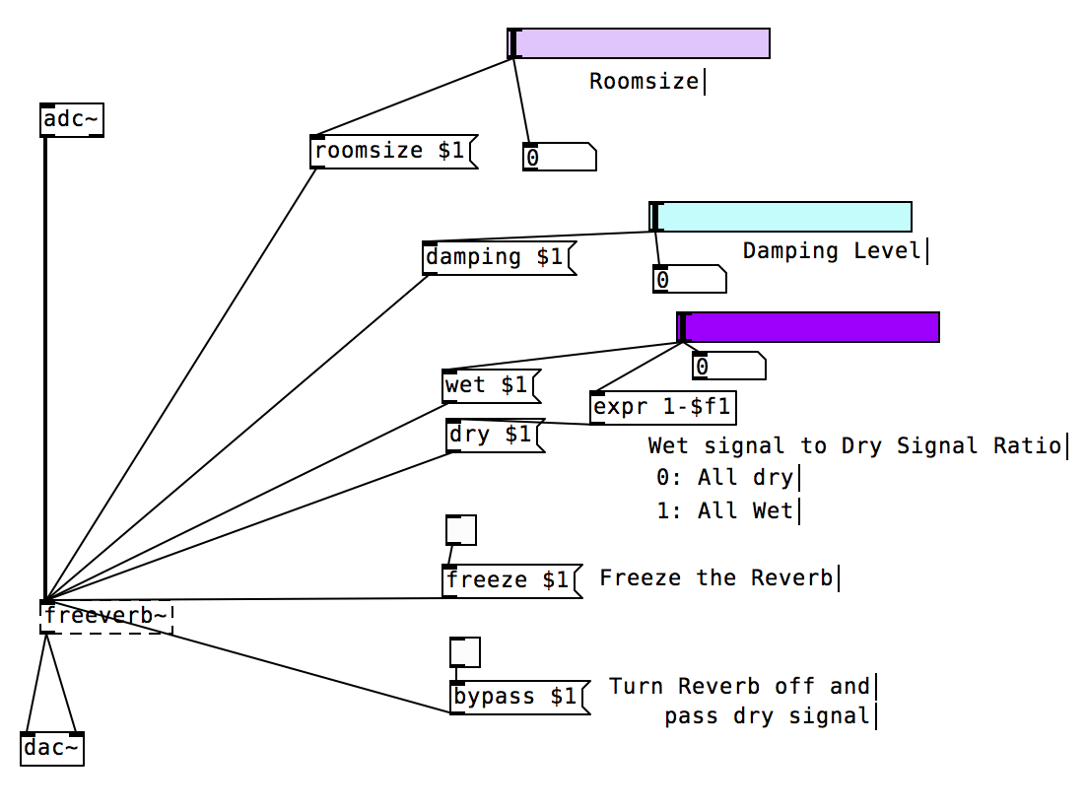
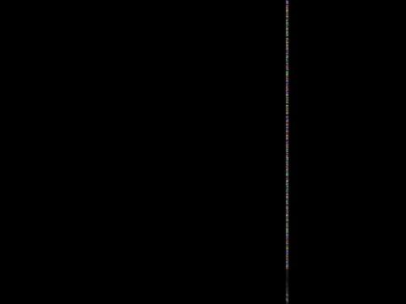
Reverb Effect
Creates the sound of a performance in a concert hall
Mirrors a large number of reflections to build up and then decay
Notes:
freeze function allows you to grab any section of your active reverb tail in real time and add continuous sustain

Slide 16
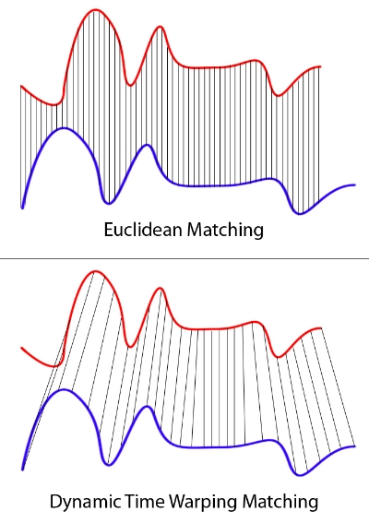
Dynamic Time Warping
Algorithm for the measurement of similarity between two temporal sequences
Calculates an optimal match in the form of a distance that is the sum of localized cost functions

Slide 17
DTW Path
The process can be thought of conceptually as arranging the two sequences on the sides of a grid
Each cell within the grid will be filled in with a distance measure comparing the corresponding elements of the two sequences

Slide 18
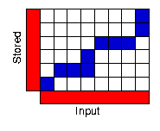
DTW Path

Slide 19
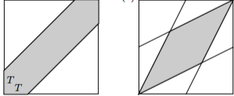
How DTW Works
To find the best path through the grid, we search for a path that minimizes the total distance between them
Without optimizations, all possible paths through the grid are calculated and a minimum is selected

Slide 20
Why DTW?
DTW is relatively insensitive to time-scale contraction or dilation in either the database or query signals
A slightly erroneous performance will register a match as long as the section is the closest match to the database sequence relative to what’s been processed so far
The algorithm is commonplace in most speech dictation software and has a wide scope of applications such as gesture recognition

Slide 21
DTW Data Mining
Find subsequence within a larger database sequence that minimizes DTW-distance to a query sequence over all possible subsequences of the database
Penalizes matches near the beginning or end of the database sequence
Assigns the min DTW-distance that is possible between the query and the subsequence of the database to the ending index of subsequence

Slide 22
Data Mining Continued
Each subsequence that produces a match will contain a start and end index
Removes all the indices within the nearest local maximums of the subsequences start and end indexes from consideration
Ignores subsequences that are only a slight shift of indices from the best match located nearby
Computational complexity is O(NM)

Slide 23
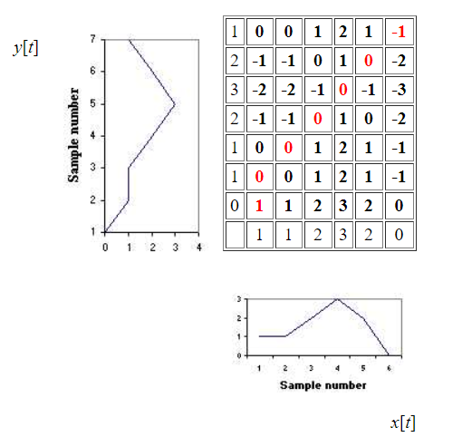
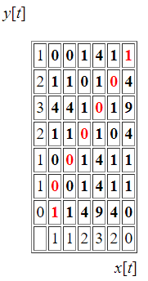
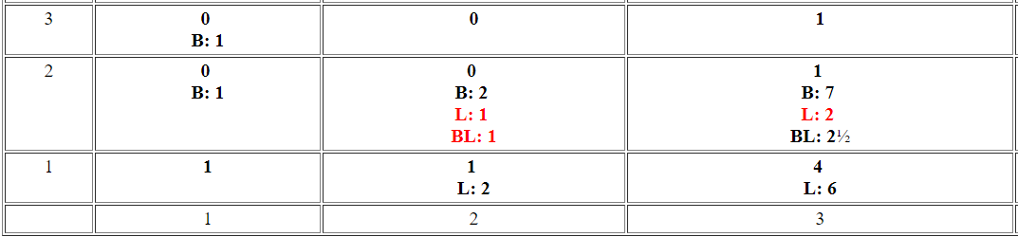
Basic Dynamic Time Warping

Slide 24
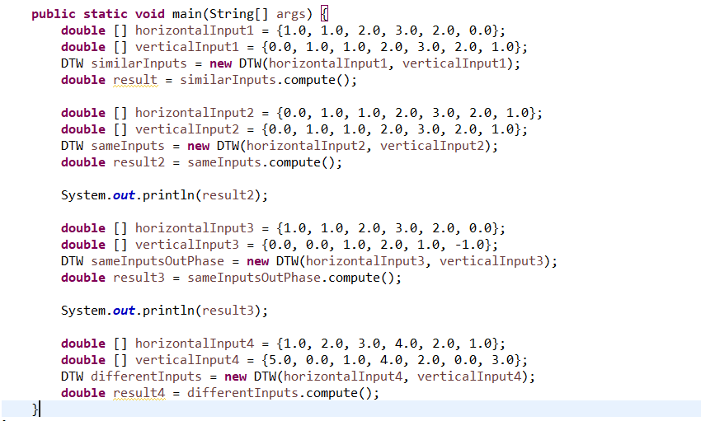
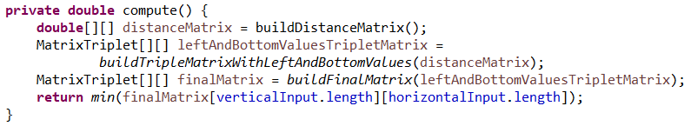
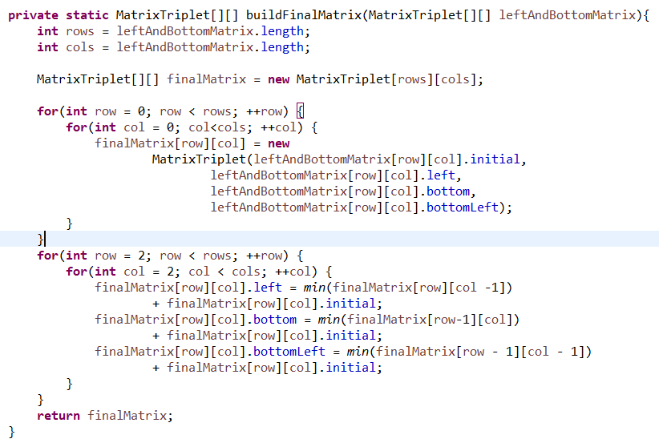
Java Implementation

Slide 25
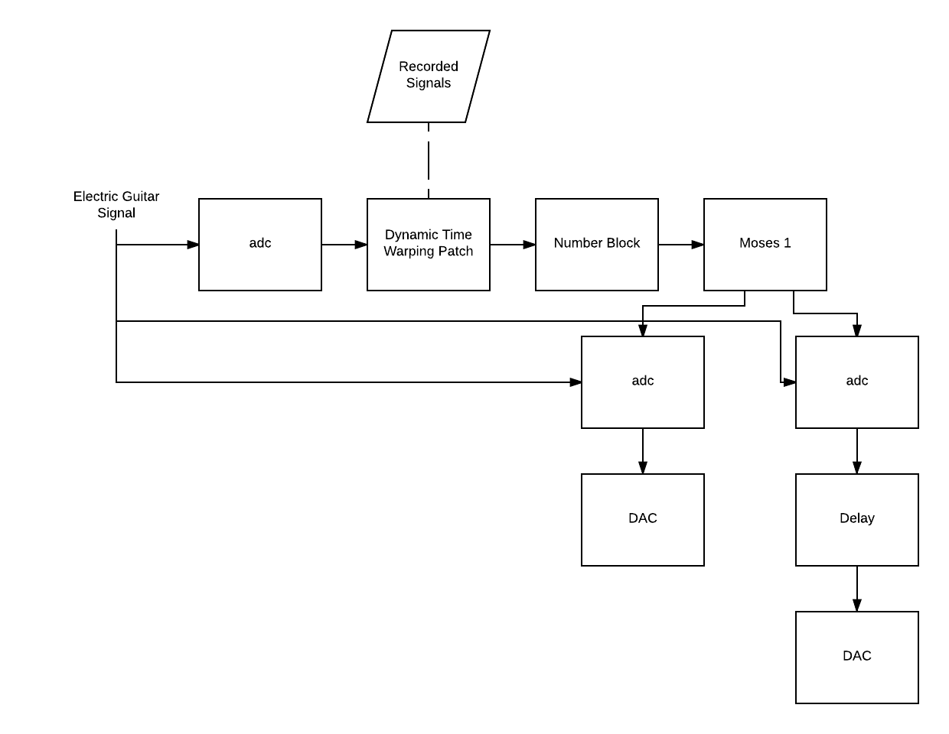
Block Diagram with DTW

Slide 26
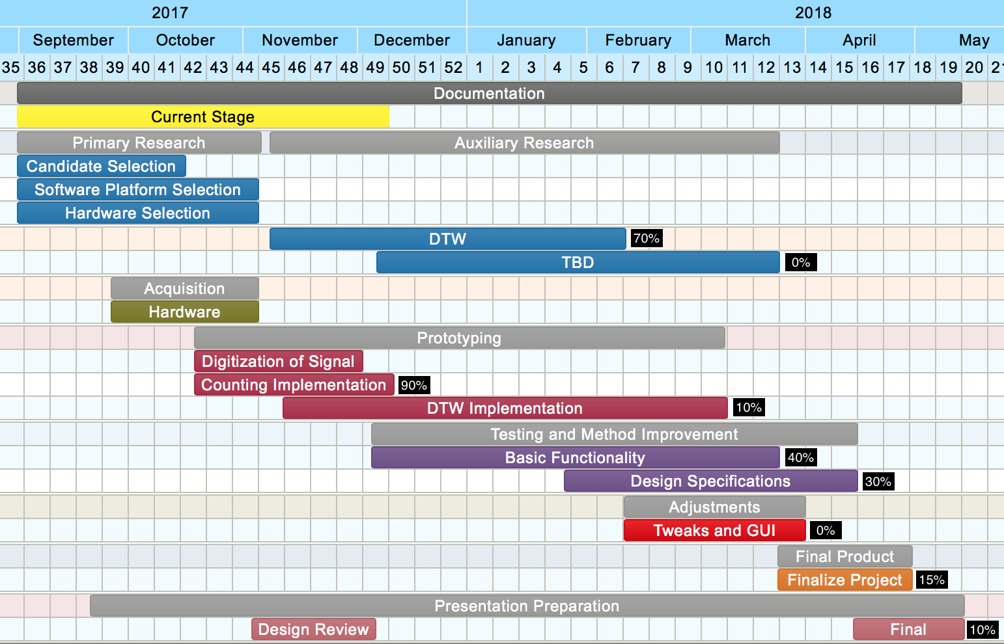
Project Schedule

Slide 27
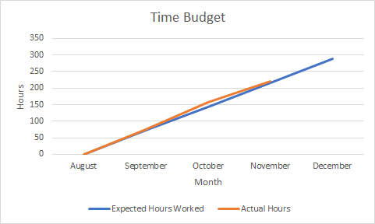
Time Budget

Slide 28
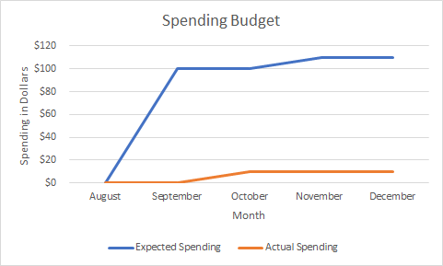
Spending Budget

Slide 29
Open Action Items
Create a Dynamic Time Warping Pure Data Object
Design a GUI
Implement ability to apply concurrent effects
Reduce counting inconsistencies

Slide 30
Summary
Created a simplified automatic guitar effects trigger system
Capable of triggering Delay Effect
Plan on implementing Dynamic Time Warping Patch
Meeting Design Criteria
Trigger Latency of <= 1 second
Minimum Note Onset separation of 10 notes per second
Concurrent/Multiple Effects Triggering Events

Slide 31
Questions?

